Slide 1

“Heckerling Update”
50th Annual Heckerling Institute, January 2016
PRESENTED BY:
Christopher J. Burns

Slide 2
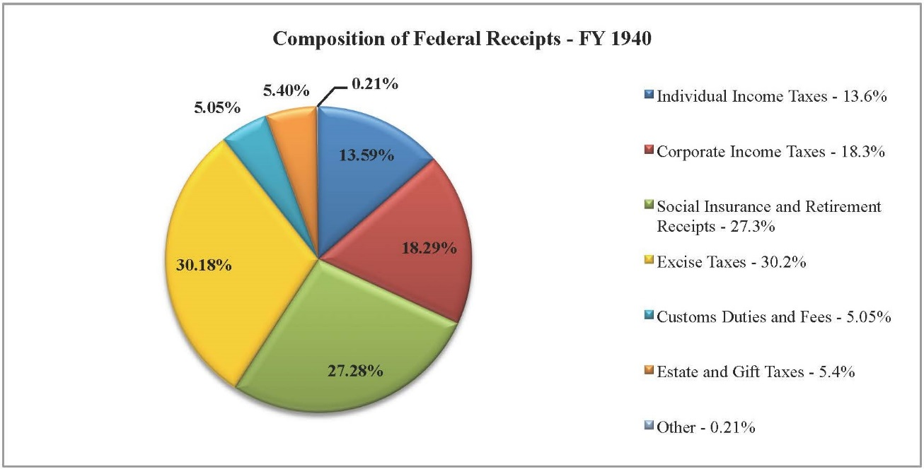
Perspective
Notes:
The following three slides are from “Make, Remake and Remodel – Trust Design and Redesign to Minimize Taxes and Maximize Family Wealth” presented by:
Robert A. Romanoff, Levenfeld Pearlstein, LLC, Chicago; and, Suzanne L. Shier, The Northern Trust Company, Chicago

Slide 3
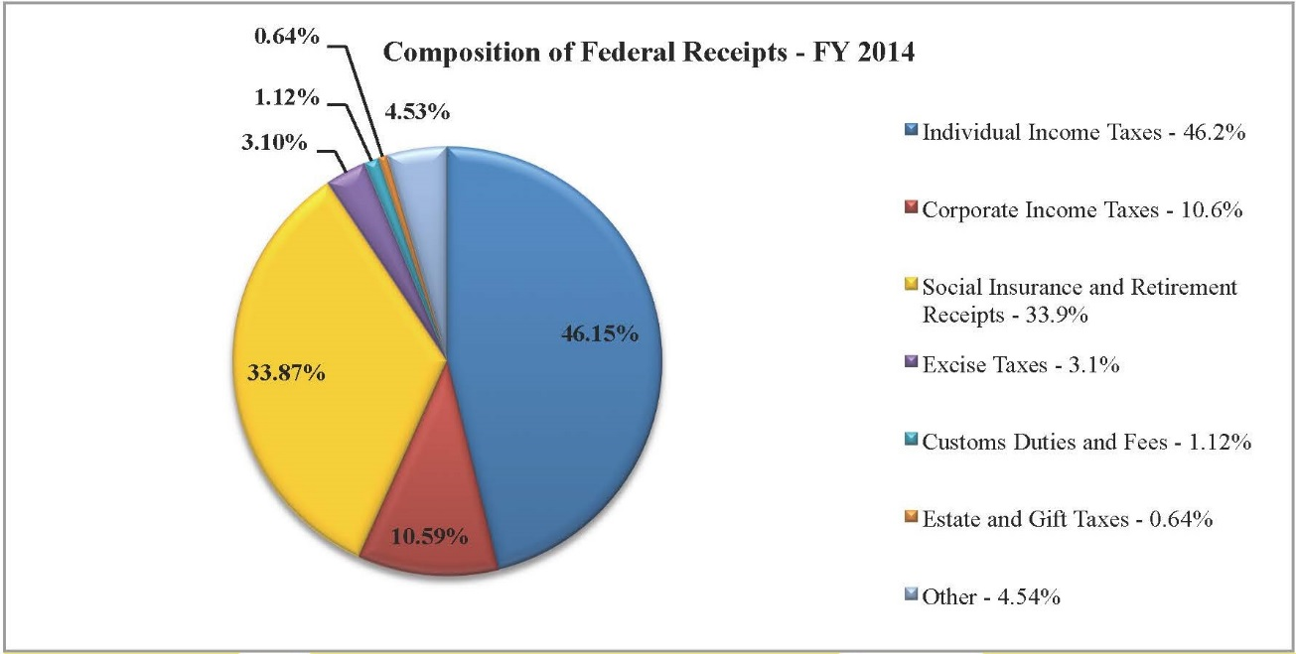

Slide 4
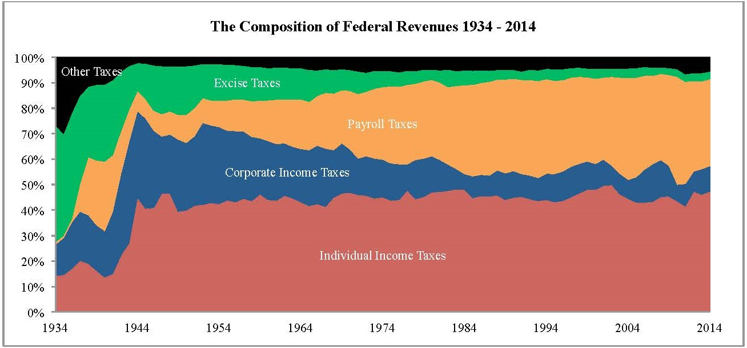

Slide 5
Recent Developments
If you missed all of 2015,
did you miss anything important?

Slide 6
Recent Developments
Section 529A; ABLE Act
    Available in Minnesota?
    Rulemaking still being refined.
    Expect to have clear direction by 2017.

Slide 7
Recent Developments, cont.
2. President Obama’s 2016
fiscal proposals**
    Restore estate tax to 2009 exemptions:$3.5 million
    Modify GRAT rules
    Modify IRC Section 6166 rules
      Certain Estate Tax Deferrals
    Simplify annual gifts
    *Note also, consistency of basis requirement. IRC 1014 (b)
** http://www.treasury.gov/resource-center/tax-policy/Documents/General-Explanations-FY2016.pdf

Slide 8
Recent Developments, cont.
3. State Taxation
State estate Tax Chart
    http://media.mcguirewoods.com/publications/State-Death-Tax-Chart.pdf
Minnesota estate tax exemption

Slide 9
Recent Developments, cont.
4. Treasury Guidance *
    IRS Priority Guidance Plan
    12 projects under heading “Gifts and Estates and Trusts”. 3 of those:
      QTIP Elections and Portability
      Defined value formula clauses
      Valuation Discounts
    New IRS Form 8971
* http://www.irs.gov/pub/irs-utl/2015-2016_pgp_initial.pdf

Slide 10
Recent Developments, cont.
5. Review of some important cases
    Cavallaro v. Commissioner, T.C. Memo 2014-189
    Estate of Redstone v. Commissioner, 145 T.C. No. 11 (October 26, 2015)
    Mikel v. Commissioner, T.C. Memo 2015-64 (April 6, 2015)
    Field Attorney Advice 20152201f (Issued March 13, 2015, released May 29, 2015)

Slide 11
Recent Developments, cont.
5. Continued
    e. Aaron v. Deloitte Tax LLP, N.Y. Sup. Ct., No 653203- 2015 (Malpractice law suit filed Sept. 24, 2015)
    f. Woelbing v. Commissioner, T.C. Docket No. 30261- 13(filed Dec. 26, 2013); and Estate of Marion Woelbing v. Commissioner, T.C. Docket No. 30260- 13 (filed Dec. 26, 2013
    g. United States v. Stiles, 2014 WL 6775263, 114 A.F.T.R.2d 2014-6809 (W.D. Pa., Dec. 2, 2014)

Slide 12
Recent Developments, cont.
6. Portability
a. Time to file
b. Extensions
7. Closing letters

Slide 13
Recent Developments, cont.
8. Uniform Law Update
9. U.S. Supreme Court in the Age of Obama

Slide 14
Practice Tips
Ascendancy of Income Tax in planning
Coping with the global, technological, and changing landscape of advising

Slide 15
IRS Audit Practice Overview
Summons power
Attorney Client privilege; other privileges
Tax opinions

Slide 16
Net Investment Income Tax
IRC Section 1411 imposes a
tax of 3.8% on certain income.

Slide 17
Lightning Round
Charitable Board Service
Estate Planning for Retirement Benefits - Natalie Choate
Institute brochure: http://www.law.miami.edu/heckerling/

Slide 18
Questions or Comments?
Christopher J. Burns
(612) 252-2833
cburns@hensonefron.com

Slide 19
Promotional materials
The announcement of this presentation stated: “While we were enjoying mid-day high temperatures of -1 in Minnesota, Christopher Burns was absorbing the content of the 50th Annual Hecklerling Institute on Estate Planning in Orlando, Florida. ”

Slide 20

To make up for the guilt of missing this . . .

